Slide 1
Communication Subsystem and Debugging

Slide 2
Classification of Embedded systems
Small scale embedded system
Medium scale embedded system
Sophisticated embedded system

Slide 3
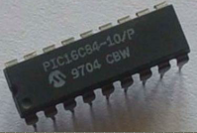
Small scale embedded system
Single 8 bit or 16 bit Microcontroller
Little hardware and software complexity
May be battery operated
Usually “C” is used for developing these systems
The need to limit power dissipation when the system is running continuously
Programming Tools: Editor, Assembler , Cross Assembler

Slide 4
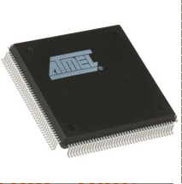
Medium scale embedded system
Single or few 16/32 bit microcontrollers or DSP or RISC
Both software and hardware complexity
Programming tools: RTOS, Source code engineering simulator, Debugger and IDE

Slide 5
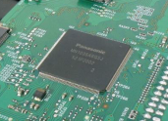
Sophisticated embedded systems
Enormous hardware and software complexity
Need scalable processor or configurable processor or programmable logic arrays
Constrained by the processing speed available in their hardware unit
Programming tools: a compiler or retargetable compiler has to be developed

Slide 6
Purpose Of Embedded Systems
Each Embedded system is designed to serve the purpose of any one or a combination of the following tasks.
1. Data collection/Storage/Representation
2. Data communication
3. Data (Signal) processing
4. Monitoring
5. Control
6. Application specific user interface

Slide 7
Data collection/Storage/Representation
1. Data collection is usually done for storage, analysis, manipulation and transmission.
2. ‘Data‛ refers all kinds of information, viz. text, voice,image, electrical signals & other measurable quantities.
3. Data can be either analog (continuous) or Digital (discrete).
4. Embedded system with analog data capturing techniques collect data directly in the form of analog and converts the analog to digital signal by using A/D converters and then collect the binary equivalent of the analog data.
5. If the signal is digital it can be directly captured without any additional interface by digital embedded system.
6. The collected data may be stored directly in the system or may be transmitted to other systems or it may be processed by the system or it may be deleted instantly after giving a meaningful representation.

Slide 8
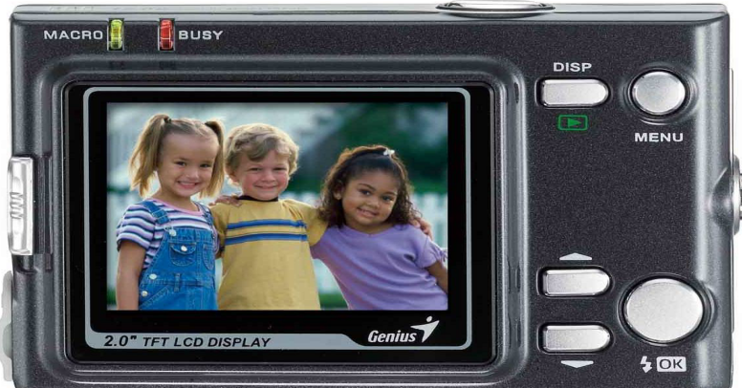
A digital camera is a typical example of an embedded system with data collection / storage / representation of data.
Images are captured and the captured image may be stored with in the memory of the camera.
The captured image can also be presented to the user through a LCD display unit.

Slide 9
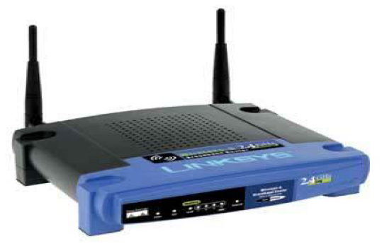
Data communication
Embedded data communication systems are developed in applications ranging from complex satellite communication systems to simple home networking systems.

Slide 10
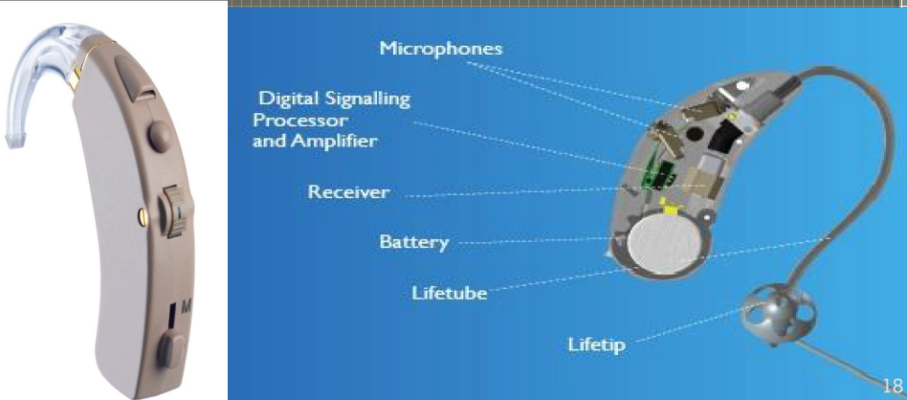
Data (Signal) Processing
The data collected by embedded system may be used for various kinds of signal processing.
A digital hearing aid is a typical example of an embedded system employing data processing.

Slide 11
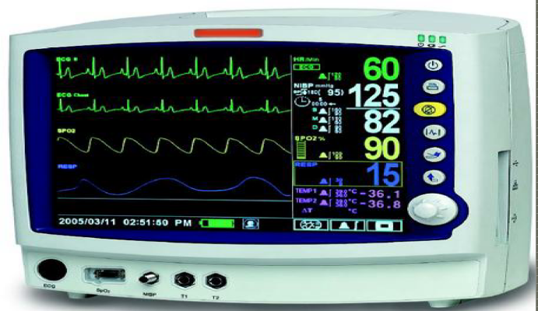
Monitoring
All embedded products coming under the medical domain are with monitoring functions only. They are used for determining the state of some variables using input sensors.
A very good example is the electro cardiogram (ECG) machine for monitoring the heartbeat of patient.

Slide 12
Control
Embedded system with control functionalities impose control over some variables according to the input variables.
A system with control functionality contains both sensors and actuators.
Sensors are inputs ports for capturing the changes in environment variables or measuring variable.
Actuators are output ports are controlled according to the changes in input variable.
Ex: An Air conditioner for controlling room temperature

Slide 13
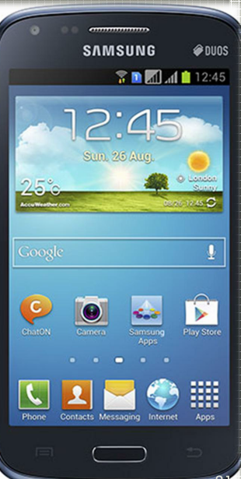
Application specific user interface
These are embedded systems with application specific user interfaces like buttons, switches, keypad, lights, bells, display units, etc..
Mobile phone is an example for this
In mobile phone the user interface is provided through the keyboard, graphic LCD module, system speaker, vibration alert, etc…

Slide 14
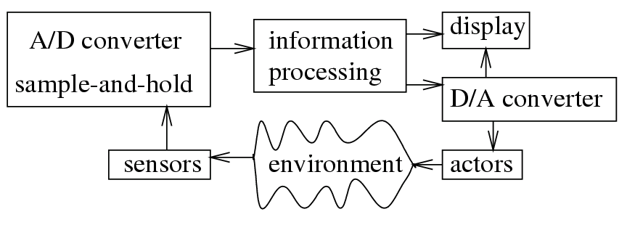

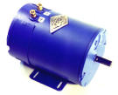
ES: Simplified Block Diagram
actuators

Slide 15
Typical Core of an Embedded system
Embedded systems are domain and application specific and are built around a central core.
The core of the embedded system falls into any one of the following categories.
1. General Purpose and Domain Specific Processors
1.1 Microprocessors
1.2 Microcontrollers
1.3 Digital Signal Processors
2. Application Specific Integrated Circuits (ASICs)
3. Programmable Logic Devices (PLDs)
4. Commercial Of The Shelf Component (COTS)

Slide 16
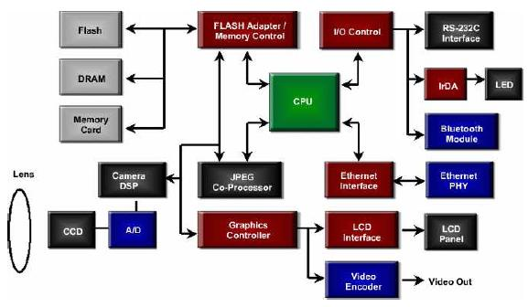
An Example Embedded System
Digital Camera Block Diagram

Slide 17
Components of Embedded Systems
Analog Components
Sensors, Actuators, Controllers, …
Digital Components
Processor, Coprocessors
Memories
Controllers, Buses
Application Specific Integrated Circuits (ASIC)
Converters – A2D, D2A, …
Software
Application Programs
Exception Handlers
Hardware
Software

Slide 18
Hardware Components

Slide 19
Hardware Components of Embedded Systems- an example
Memory
Controllers
Interface
Software
(Application Programs)
Coprocessors
Processor
ASIC
Converters
Analog
Digital
Analog

Slide 20
Sensors and Actuators
Sensor
A sensor is a transducer device that converts energy from one form to another for any measurement or control purpose.
Actuator
Actuator is a form of transducer device which converts signals to corresponding physical action(motion).
Actuator act as output device

Slide 21
The I/O Subsystem
The I/O Subsystem of the embedded system facilitates the interaction of the embedded system with the external world.
Interaction happens through the sensors and actuators connected to the input and output ports respectively of the embedded system.
The sensors may not be directly interfaced with input ports, instead they may be interfaced through signal conditioning and translating like ADC, optocouplers,etc..

Slide 23
Communication Interface
For any embedded system, the communication interfaces can be broadly classified into
On board Communication Interface or (Device/Board level communication interface)
External Communication Interface or(Product level communication interface)

Slide 24
Onboard Communication Interfaces
These are used for internal communication of the embedded system i.e: communication between different components present on the system.
Common examples
•Inter Integrated Circuit(I2C)
•Serial Peripheral Interface(SPI)
•Universal Asynchronous Receiver Transmitter(UART)
•1-WireInterface
•Parallel Interface

Slide 25
External or Peripheral Communication Interfaces
These are used for external communication of the embedded system i.e: communication of different components present on the system with external or peripheral components/devices
Common examples of external interfaces are:
•RS-232 C & RS-485
•Universal Serial Bus (USB)
•IEEE 1394 (Firewire)
•Infrared (IrDA)
•Bluetooth
•Wi-Fi
•ZigBee
•General Packet Radio Service (GPRS)Example: RS-232 C & RS-485

Slide 26
Serial Communication
A single wire used for data transfer
One or more additional wires used for control (but, some protocols may not use additional control wires)
Higher throughput for long distance communication
Often across processing node
Lower cost in terms of wires (cable)
E.g., USB, Ethernet, RS232, I²C, etc.
26

Slide 27
Parallel Communication
Multiple buses used for data transfer
One or more additional wires used for control
Higher throughput for short distance communication
Data misalignment problem
Often used within a processing node
Higher cost in terms of wires (cable)
E.g., ISA(Industry Standard Architecture ), AMBA(Advanced Microcontroller Bus Architecture) , PCI, etc.
27

Slide 28
Wireless Communication
Infrared (IR)
Electronic wave frequencies just below visible light spectrum
Diode emits infrared light to generate signal
Infrared transistor detects signal, conducts when exposed to infrared light
Cheap to build
Need line of sight, limited range
Radio frequency (RF)
Electromagnetic wave frequencies in radio spectrum
Analog circuitry and antenna needed on both sides of transmission
Line of sight not needed, transmitter power determines range
28

Slide 29
(Device/Board level communication interface)
a) I²C Inter Integrated Circuit
b) SPI (Serial Communication Interface)
c) UART (Universal Asynchronous Rx and Tx)
d) 1-WIRE
e) Parallel Communication Interface

Slide 30
SPI (Serial Communication Interface)

Slide 31
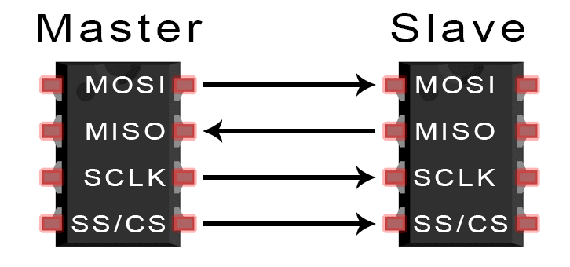
SPI
SPI is a synchronous communication protocol
Devices communicating via SPI are in a master-slave relationship.
The master is the controlling device (usually a microcontroller), while the slave (usually a sensor, display, or memory chip) takes instruction from the master.
The simplest configuration of SPI is a single master, single slave system, but one master can control more than one slave
MOSI (Master Output/Slave Input) – Line for the master to send data to the slave.
MISO (Master Input/Slave Output) – Line for the slave to send data to the master.
SCLK (Clock) – Line for the clock signal.
SS/CS (Slave Select/Chip Select) – Line for the master to select which slave to send data to

Slide 32
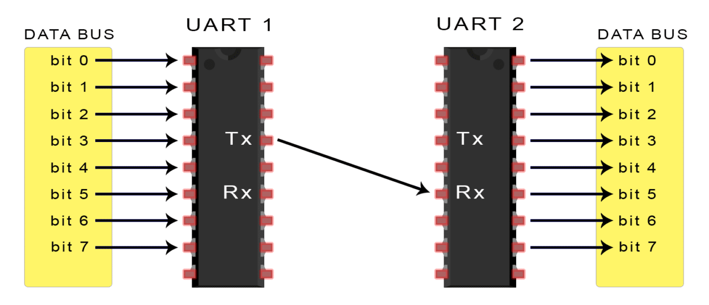
UART (Universal Asynchronous Rx and Tx)

Slide 33
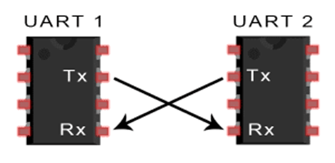
UART
UART: Universal Asynchronous Receiver Transmitter
Takes parallel data and transmits serially
Receives serial data and converts to parallel
It’s not a communication protocol like SPI and I2C, but a physical circuit in a microcontroller, or a stand-alone IC.
A UART’s main purpose is to transmit and receive serial data.
One of the best things about UART is that it only uses two wires to transmit data between devices.
UARTs being used in many DIY electronics projects to connect GPS modules, Bluetooth modules, and RFID card reader modules to Raspberry Pi, Arduino, or other microcontrollers.
33

Slide 34
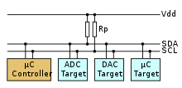
I²C Inter Integrated Circuit
Serial communication protocol that can connect low-speed devices.
It is a master-slave communication in which we can connect and control multiple slaves from a single master.
In this, each slave device has a specific address.
It is widely used protocol for short-distance communication.
It is also known as Two Wired Interface(TWI).

Slide 35
I²C Applications
System management for PC systems via SMBus
Accessing real-time clocks and NVRAM chips that keep user settings.
Accessing low-speed DACs and ADCs.
Changing backlight, contrast, hue, color balance settings etc in monitors (via Display Data Channel).
Changing sound volume in intelligent speakers.
Controlling small (e.g. feature phone) LCD or OLED displays.
Reading hardware monitors and diagnostic sensors, e.g. a fan's speed.
Turning on and off the power supply of system components.

Slide 36
1-WIRE
1-Wire is a device communications bus system designed by Dallas Semiconductor Corp. that provides low-speed(16.3 kbit/s) data, signaling, and power over a single conductor.
1-Wire is similar in concept to I²C, but with lower data rates and longer range.
It is typically used to communicate with small inexpensive devices such as digital thermometers and weather instruments.
A network of 1-Wire devices with an associated master device is called a MicroLAN.

Slide 37
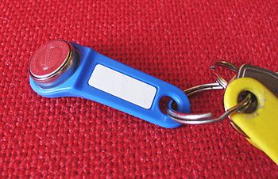
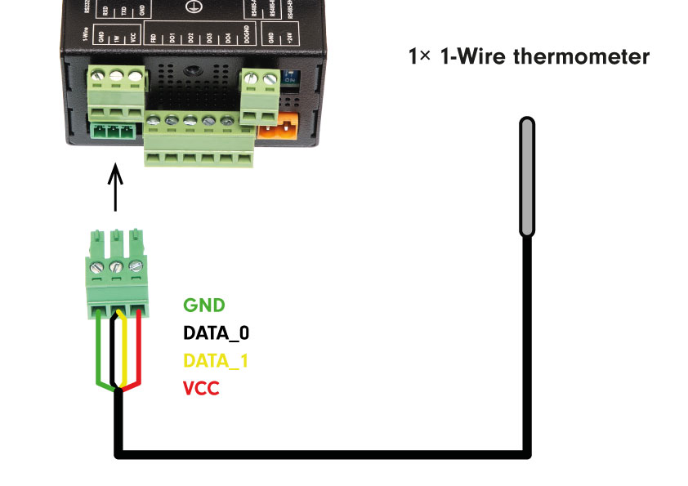
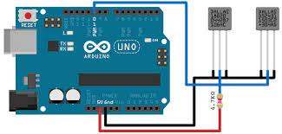
1-WIRE
The protocol is also used in small electronic keys known as a Dallas key or iButton.

Slide 38
Parallel Communication Interface

Slide 39
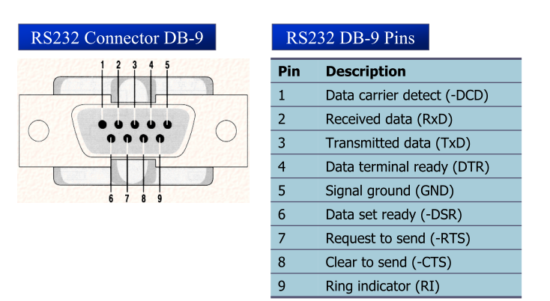
SERIAL COMMUNICATION RS232 Standards
An interfacing standard RS232 was set by the Electronics Industries Association (EIA) in 1960

Slide 40
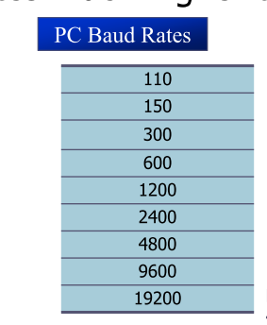
SERIAL COMMUNICATION PROGRAMMING
To allow data transfer between the PC and an 8051 system without any error, we must make sure that the baud rate of 8051 system matches the baud rate of the PC’s COM port
Hyper terminal function supports baud rates much higher than listed below

Slide 41
Real Time Systems
Real Time Systems
Real Time Operating Systems
Application Development
Loading Applications
Testing Applications

Slide 42
What is Real time?
Real-time is the ability of the control system to respond to any external or internal events in a fast and deterministic way.
A system is deterministic if the response time is predictable.
The lag time between the occurrence of an event and the response to that event is called latency
Deterministic performance is key to Real-time performance.

Slide 43
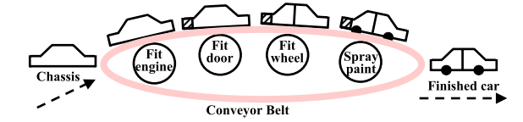
Industrial Applications
Chemical Plant Control
Automated Car Assembly Plant
Supervisory Control And Data Acquisition (SCADA)
Energy Management system/Smart Grid
Network traffic mgt
Medical electronics
Robotic surgery
MRI Scanners/CT scans
Radiation units
Peripheral devices
Automotive and Transportation
automotive engine control systems,
road traffic signal control, air-traffic control, high-speed train control,
car navigation systems, and MPFI engine control systems
Many more

Slide 44
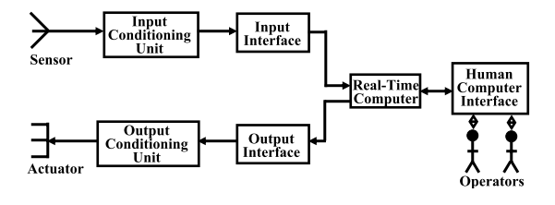
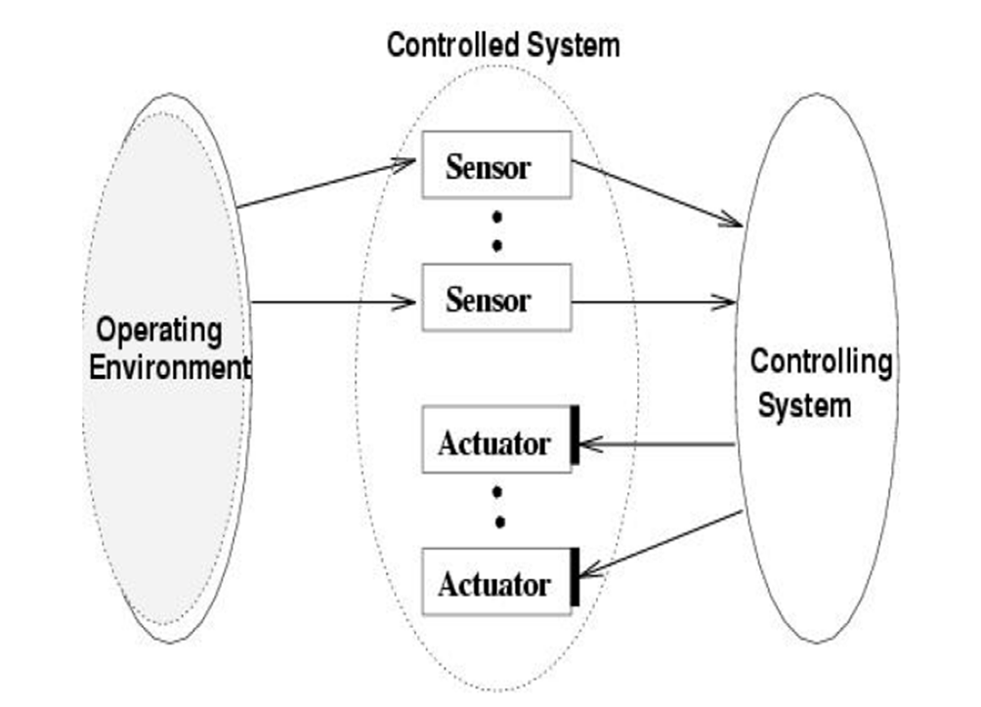
A Basic Model of a Real-Time System

Slide 45
Characteristics of Real-Time Systems
Time constraints: One form of time constraints that is very common is deadlines associated with tasks
New Correctness Criterion: In real-time systems, correctness implies not only logical correctness of the results, but the time at which the results are produced is important
Embedded:
Safety-Criticality
Task Criticality: measure of the cost of failure of a task
Concurrency
Distributed and Feedback Structure

Slide 46
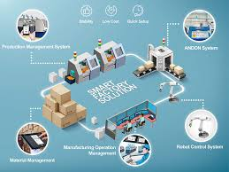
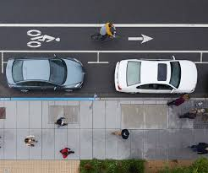
Real time systems and OS
A real time OS is an operating system that will help implement any real time system
Requirements
High speed execution
Multitasking
Inter task communications
Deterministic response
Low Interrupt Latency
Fast Response “ A late answer is a wrong answer..”

